Slide 1
Accommodations 101:
Testing
Office of Accessibility
The University of Akron
Simmons 105
Notes:
Welcome to Accommodations 101: Testing, presented by the Office of Accessibility at The University of Akron.

Slide 2
Objectives
Participants will:
Gain understanding of a variety of testing accommodations
Gain an understanding of how to provide students with the testing accommodation
Notes:
In this presentation, viewers will learn information about the Office of Accessibility, as well as gain an understanding of a variety of testing accommodations and how to provide students with this accommodation.

Slide 3
Testing Accommodations
Notes:
Today we will discuss testing accommodation, which are common accommodations that some students with disabilities may receive.

Slide 4
Types of Testing Accommodations
Extended time
  The specific amount of extended time depends on the impact of the disability and is determined by the student’s Disability Specialist.
Distraction-reduced space
  Small, quiet rooms are available for testing; we are unable to guarantee isolated space.
Test proctors (reader and/or scribe)
  Readers may read and repeat test questions verbatim for student; Scribes write answers to test questions verbatim as dictated by student.
Use of technology on tests
  Includes computers, CCTV, adaptive software, etc. depending on students’ disability-related needs. Students are not able to use their own personal devices when testing.
Notes:
There are various types of testing accommodations that a student may receive, depending on the type and severity of their dsiability.
Many students will receive extended time on their exams. The specific amount of extended time will depend on the impact of the student’s disability, and is determined during the intake appointment with the student’s Disability Specialist.
Additionally, many students will receive testing in a distraction reduced space. This means tests and quizzes should be taken away from the rest of the class in a quiet space. The Office of Accessibility is not able to guarantee to any student that they will take their exams in full isolation.
Some students may require the use of a reader or scribe for their exams. Readers will read and repeat test questions verbatim. They do not interpret questions, reword questions, or provide definitions to the student testing. A scribe assists a student with writing, and will write down answers to exam questions verbatim as dictated by the student.
Finally, some students will use technology on exams, such as a computer for essay questions, adaptive software, or a CCTV, depending on the student’s needs. This technology is provided by the Office of Accessibility, and students are not permitted to use their own personal devices while testing.

Slide 5
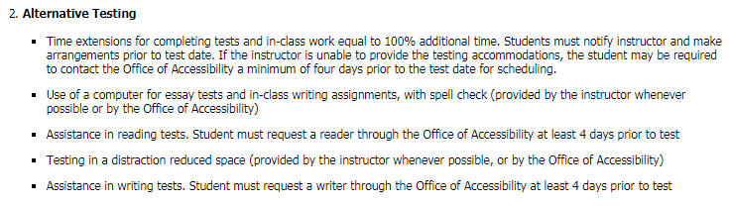
Options for Testing
Faculty will receive students’ accommodation letter(s) via email which indicates specific accommodations for which each student is eligible
Sample language from Letter of Accommodation regarding Testing:
Notes:
The student’s specific testing accommodations will be listed on their accommodation letter, which is emailed to each faculty member, usually at the beginning of the semester. This letter will indicate the amount of extended time, types of technology a student may be eligible for, and the location at which a student will take their exams.

Slide 6
Alternative Testing Locations
In order to effectively provide testing accommodations to a large number of students, alternative testing may occur in one of the following locations based on the individual student’s need.
Alternative Testing Locations
Counseling and Testing Center (Simmons 304)
Office of Accessibility (Simmons 105)
Computer Based Assessment & Evaluation (Schrank North 153)
Notes:
There are a number of options students can utilize when it comes to taking exams.
Students are welcome to forego their accommodations and take their exams with the rest of the class.
Instructors are also welcome to proctor their own exams whenever possible.
If the instructor is not able to provide testing accommodations, the student will take their exams at their assigned testing location, which is determined during the intake appointment and indicated on the student’s accommodation letter. Students will either test in the Counseling Center-Testing Services, or in the Office of Accessibility.
For classes that utilize the Computer Based Assessment and Evaluation Center in Schrank Hall, students also have the option of receiving their testing accommodations at that location.

Slide 7
Options for Testing
Students have the right to choose whether they wish to utilize testing accommodations for each quiz/test/exam.
Students may take tests with the class without utilizing accommodations.
If students wish to complete the test without accommodations they cannot:
  Retake the test if they do not receive the grade they anticipate
  Receive accommodations on the spot, if not prearranged
Some professors prefer to work with students to agree on an appropriate time/place for testing. This is acceptable as long as student agrees to the arrangement.
Notes:
Students are welcome to forego their accommodations and take their exams with the rest of the class. However, students are reminded that accommodations are not retroactive, and once they have chosen not to use the accommodation, they will not be permitted to retake the exam with accommodations if they do poorly.
Instructors are welcome to proctor their own exams whenever possible. In this case, the student and their faculty member coordinate a place and time for receiving the testing accommodations. This scenario is typically ideal for students, as they have access to the instructor should any questions come up during testing.

Slide 8
Testing Locations
Counseling and Testing Center
Students who test here most commonly require:
Extended Time
Distraction-Reduced Space
Use of Computer
Contact Information
Simmons Hall 304
330-972-7084
CCTesting@uakron.edu
Notes:
If the student would like to utilize their testing accommodations, but the instructor is not able to provide the accommodation, the student can take their exam at their assigned location. This location is indicated on the student’s accommodation letter.
Students who only require extended time and distraction reduced space will often take their exams in the Counseling Center-Testing Services. This center is located in Simmons Hall 304, and provides a quiet testing space for students.

Slide 9
Testing Locations
Office of Accessibility
Students who test here most commonly require:
Extended Time
Distraction-Reduced Space
Use of Computer
Proctor (Reader/Scribe)
Alternative Technology (Dragon, screen enlargement, Braille, etc.)
Contact Information
Simmons Hall 105
330-972-7928
Access@uakron.edu
Notes:
Student who require readers, scribes, or alternative technology will typically take their exams in the Office of Accessibility. The Office of Accessibility is located in Simmons Hall 105.

Slide 10
Testing Locations
Computer Based Assessment and Evaluation (CBAE)
For courses which usually utilize CBAE for testing services, accommodations can still be provided in this locations
Students who test in CBAE must:
Provide CBAE with Letter of Accommodation for the course
Call in advance to reserve a Distraction Reduced testing room
Submit an online Test Request through STARS IF a proctor is needed
Contact Information
Schrank North 153
330-972-6511
testing@uakron.edu
Notes:
Student who require readers, scribes, or alternative technology will typically take their exams in the Office of Accessibility. The Office of Accessibility is located in Simmons Hall 105.

Slide 11
Testing Locations
Computer Based Assessment & Evaluation
IMPORTANT Tips for faculty:
  If a CBA&E test is delivered in a Brightspace format, the instructor must adjust the time extension.
  If the test is offered in another format (i.e. Perception Assessment System) CBA&E will adjust the extended time.
  For more information, please visit the Computer Based Testing Practice & Policies for faculty website : http://www.uakron.edu/it/instructional_services/cbae/testing-practice-policies.dot
Notes:
If a student has requested extended time, it may be the responsibility of the instructor to adjust the time if the exam if offered through Springboard.
Exams that are offered in other formats, such as Perception, will have the time adjusted by the staff at CBA &E. Faculty and staff can view more information about the testing practices and polices at CBA&E on their website.

Slide 12
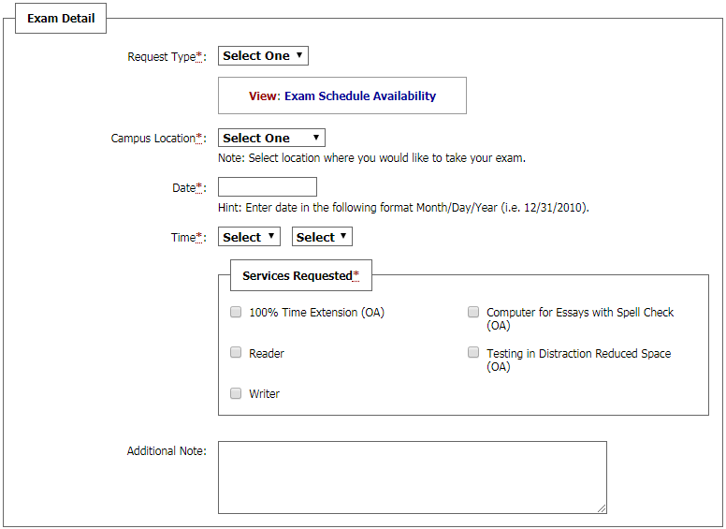
Guidelines for Scheduling Tests
Students must schedule tests in STARS (Student Testing and Accommodation Request System)
Requests should be completed at least 4 business days before the desired test day.
Notes:
Students who wish to use either the Counseling Center-Testing Services or the Office of Accessibility for taking exams must schedule their tests through STARS, the Office of Accessibility’s online request system. Students will input the type of exam they are taking, the date and time they are taking the exam, and which accommodations they would like to use for the exam.
Whenever possible, we ask students to request their exams at least 4 business days in advance.

Slide 13
Guidelines for Scheduling Tests
We recommend that students schedule exams on the same date/time as the rest of the class
Exceptions may occur when students have back-to-back classes (additional exam time could run into the student’s next scheduled class)
Once a request is made:
  Appropriate testing location receives notification and reserves a room for the student.
  The professor receives an email notification request to send exam and proctor sheet to the appropriate testing location.
  The professor should contact the student if the requested date and time are not acceptable.
Finals/Midterms are high volume times and requests should be made further in advance
Notes:
The Office of Accessibility recommends that students schedule their exams at the same date and time as the rest of the class. However, students may need to schedule at a different time if there are conflicts with other classes. Students with back to back classes may not be able to take their exams at the same time as the rest of the class so they don’t miss another class. Requests for finals and midterms should be made early, as space can be limited during these times.
Once a student submits an exam request, the testing location and the professor are notified of the request. The instructor receives an email notification with the request details and information on how to send the exam to the appropriate location, along with a proctor sheet.

Slide 14
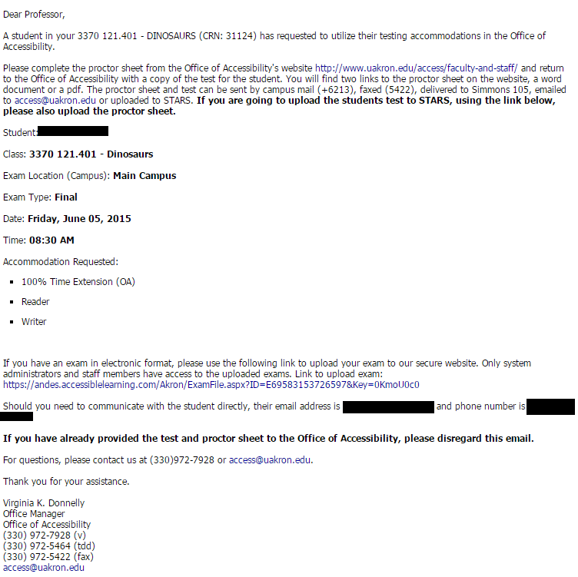
Guidelines for Scheduling Tests
Professor receives a notification email once a student submits a test request:
Use this link to access the proctor sheet
Letters in parenthesis indicate the student’s
testing location. “OA”- Office of Accessibility
“CC”- Counseling and Testing Center
Notes:
Once the student has submitted an exam request, the instructor will get an automated email from STARS. This email will include the exam details, including the student’s name, the class, the date and time the student is taking the exam, and the accommodations that the student has requested. Additionally, the email provides details on the testing site the student where the student will be taking the exam, and instructions for getting the exam to that site. It also provides instructions on how to upload an exam to the STARS system for your convenience.

Slide 15
Providing Exams
Professor sends test to the appropriate testing location at least 24 hours before the scheduled exam time.
Acceptable methods for providing tests:
Hand deliver
Email to appropriate testing location
Upload to STARS via the link provided in notification email
Notes:
Once the student has submitted an exam request, the instructor will get an automated email from STARS. This email will include the exam details, including the student’s name, the class, the date and time the student is taking the exam, and the accommodations that the student has requested. Additionally, the email provides details on the testing site the student where the student will be taking the exam, and instructions for getting the exam to that site. It also provides instructions on how to upload an exam to the STARS system for your convenience.

Slide 16
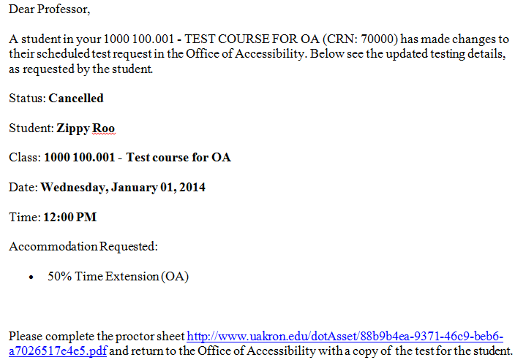
Guidelines for Scheduling Tests
Please Note: Professor will also receive email if student CANCELS or MODIFIES a test request
Notes:
If a student cancels an exam request, the instructor will also get an email indicating the changes made to the test request.

Slide 17
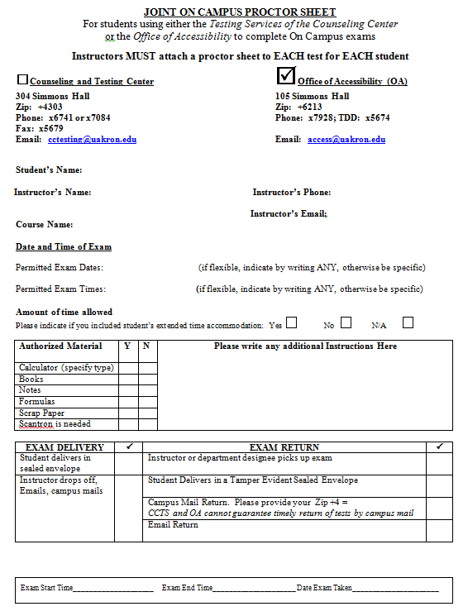
Guidelines for Scheduling Tests
Professor completes the Proctor Sheet and indicates which location to send exam to (example):
Notes:
Instructors are asked to submit a completed proctor sheet with each exam. The proctor sheet will indicate which location to send the exam to. This also provides the testing location with information about the student, and any special instructions for the exam. The testing location will not allow a student to take anything into the exam room that is not indicated on the proctor sheet. Additionally, the proctor sheet allows the testing location to know how the instructor would like the exam returned once it is complete.

Slide 18
Guidelines for Scheduling Tests
Academic Integrity
Academic integrity policies are posted and enforced in both testing locations
The Office of Accessibility and the Counseling and Testing Center are committed to the highest academic standards possible
A closed-circuit video system is used to monitor tests
If a student utilizes any unauthorized resource during a test, the situation will be reported to the course instructor
The Office of Accessibility will also report the situation to The Department of Student Conduct and Community Standards
Notes:
Both the Counseling Center-Testing Services and the Office of Accessibility are committed to upholding the academic integrity of exams given in the office. All testing rooms in both locations are monitored by closed-circuit video systems. Any student who utilizes any unauthorized materials during a test will be reported to the course instructor, and may be reported to the Department of Student Conduct and Community Standards.
Students are made aware of the academic integrity policies during their intake appointment, and again once in a testing room, as policies are posted in both testing locations.

Slide 19
The Office of Accessibility values collaboration between you, your students and our office. Thank you for your time and participation.
Office of Accessibility
Simmons Hall 105
330-972-7928 www.uakron.edu/access
If you would like an electronic copy of this presentation, please feel free to contact the office at access@uakron.edu.
Notes:
The Office of Accessibility welcomes any questions or concerns that faculty and staff have when working with students with disabilities. Please feel free to contact the office to discuss the information in this presentation, or with any other questions or concerns.

Slide 20
Accommodations 101:
Testing
Office of Accessibility
The University of Akron
Simmons 105

